Slide 1
Module 5 Physical Design and Governance of Data Warehouses
Lesson 2: Scalable Parallel Processing Approaches
Notes:
Welcome to Lesson 2 of Module 5 on Physical Design and Governance of Data Warehouses
Opening question
How does parallel processing in Hadoop differ from parallel database processing?
What does the name Hadoop mean?

Slide 2
Lesson Objectives
Discuss importance of scalable parallel processing
Explain Hadoop components
Discuss usage of Hadoop for data integration
Notes:
Lesson 2 covers architectures for scalable parallel processing.
Objectives:
Understand the growing importance of parallel processing and distributed file systems, particularly Hadoop for data integration tasks

Slide 3
Timeline of Scalable Parallel Processing
Origins
Project Nutch (2002)
Google File System (2003)
Hadoop
Open source project (2005)
Cloudera founding (2009)
Map Reduce paper (2004)
Hadoop 2 (2013)
Notes:
Hadoop history: https://gigaom.com/2013/03/04/the-history-of-hadoop-from-4-nodes-to-the-future-of-data/
Apache Nutch, an open source web search engine
Map Reduce was a Google algorithm
Maintained by the Apache Foundation
Hadoop was created by Doug Cutting and Mike Cafarella in 2005. Cutting, who was working at Yahoo! at the time, named it after his son's toy elephant..
Cloudera was the first commercial Hadoop company
Spawned dozens of startups and hundreds of millions of venture capital since 2008
Hadoop 2: open

Slide 4

Open source project with commodity components
API and services for parallel processing and job management
Distributed file system
Extensible for multiple task models
Notes:
Scalable parallel processing for big data
Uses distributed file system to support parallel processing
Services
Automatic parallelization
Load balancing
Fault tolerance for failures
Network and disk transfer optimization
Only one task type supported in first version: processing of <key, value> pairs
Somewhat tedious to setup and program but improved tools are being developed
Many parallel processing solutions for enterprise DBMSs but mainly focused on query processing

Slide 5
Hadoop Evolution
Notes:
HADOOP 2
What’s New
Sanjay R adia and Suresh Srivinas
February 2014 Vol. 39, No. 1 (www.usenix.org)
Hadoop evolution
Single task type in Hadoop 1: MapReduce on <key, value> pairs
Hadoop 2: resource negotiator (YARN) to support extensible task types with different data formats

Slide 6
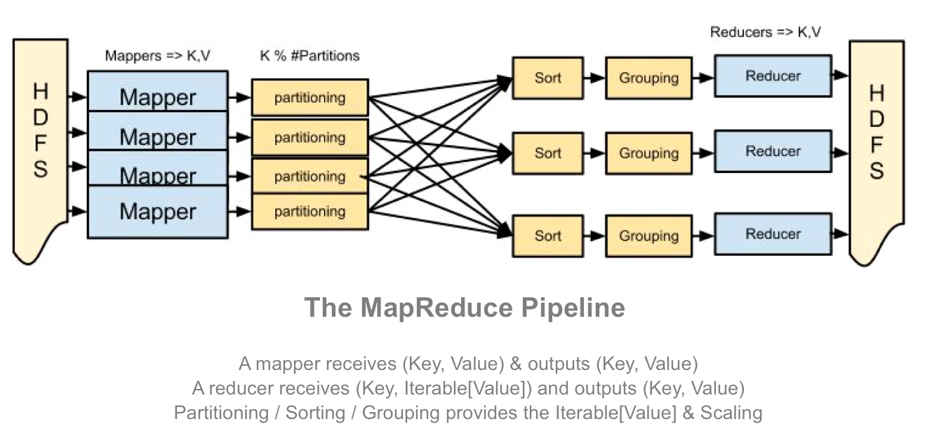
MapReduce Framework
Notes:
From: http://blog.matthewrathbone.com/2013/04/17/what-is-hadoop.html
MapReduce was developed by Google in the early 2000s.
API and services for managing parallel execution of workflows
Batch processing support only
Map: extract important parts of input
Reduce: aggregate, filter, or transform
Default partitioning, sorting, and grouping
Dependency free
No dependency between any pair of functions of the same task.
No need to share state
Easy distribution of pipeline to nodes
Example MapReduce
Map: extract 5 word sequences from web pages
Reduce: Combine counts for each identical 5 word sequence if count is large enough
Useful in many tasks in Google’s web computing
Count of URL access frequency: map extracts URLs and reduce adds access counts for the same URL

Slide 7
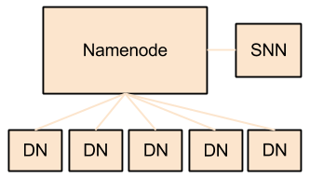
Distributed File System
Notes:
From: http://blog.matthewrathbone.com/2013/04/17/what-is-hadoop.html
Hadoop Distributed File System:
File system layer for large distributed systems
Optimized for throughput
Components:
Namenode: controller for the cluster, containing all meta such as blocks in each data node
SNN (Secondary Name Node): maintains log and periodic filesystem copies for reliability
Data Node: stores data; potentially thousands of data nodes

Slide 8
Data Integration Usage
Extend traditional data integration processing
Transform large data sets
Additional transformations, integration, and loading
Extensions of data integration tools with Hadoop
Notes:
More big data applications with Hadoop 2
More data formats supported
More application frameworks supported
Not a DW replacement as big data processing focus (batch); data formats too simple
DW loading impact
Major DBMS vendors use lots of parallel processing for DW queries

Slide 9
Summary
Scalable, reliable parallel processing using commodity components
Wide usage of Hadoop 2 open source project
Growing importance of Hadoop for extended data integration
Notes:
Much vendor innovation especially for materialized views, bitmap indexing, architectures, appliances, and cloud services
Hadoop is a strong trend embraced by many vendors

